Slide 1
Test Case Design (1/4)
Test Scenario
Test Case
Test Data
Acceptance test

Slide 2
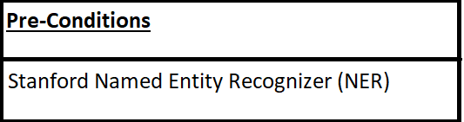
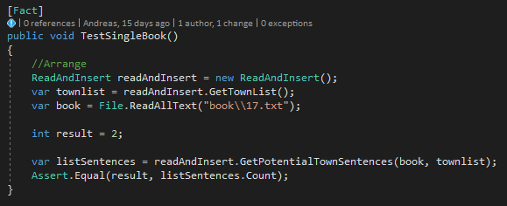
Test Case Design (2/4)
Pre conditions

Slide 3
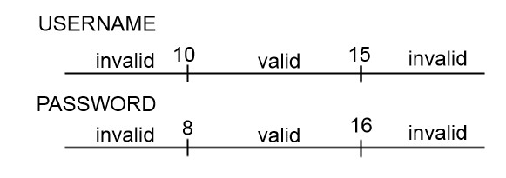
Test Case Design (3/4)
Equivalence partition
Valid Bounderies
Decision Table
Different State Table
Username | Password | Result
Right | Wrong | Login Unsuccessful
Wrong | Right | Login Unsuccessful
Right | Right | Login successful
Wrong | Wrong | Login Unsuccessful

Slide 4
Test Case Design (4/4)
Test Steps
Expected Result
Test Steps
1) Open index.html in browser
2) Click ”Create new account”
3) Fill out information
4) Click submit

